Slide 1
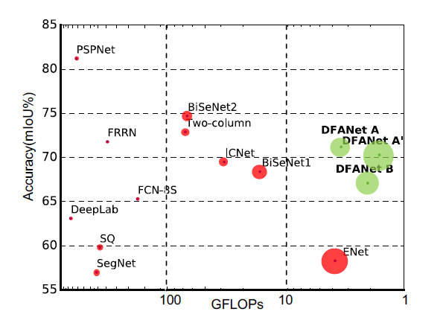
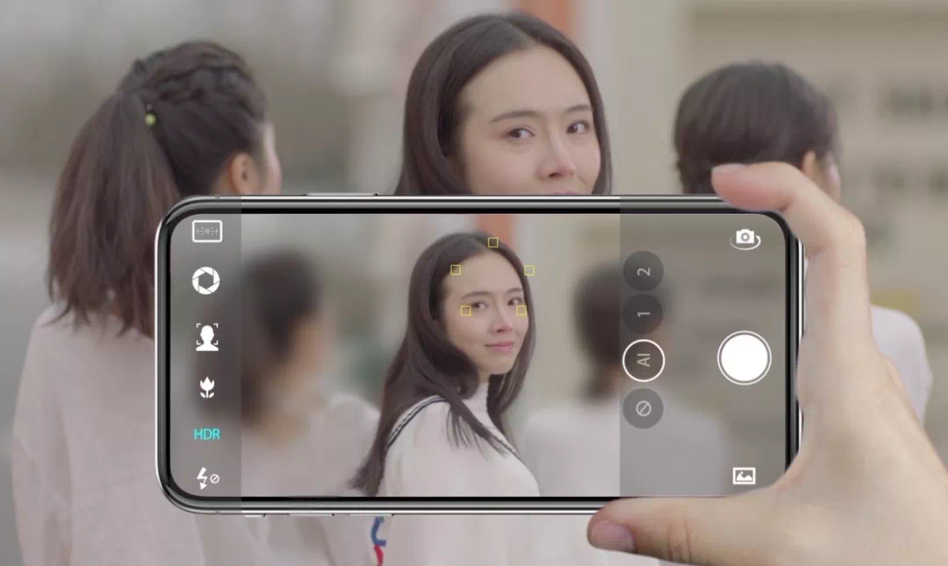
01 课题背景及意义
02 课题意义
03 主要任务
DFANet: Deep Feature Aggregation for Real-Time Semantic Segmentation
Hanchao Li, Pengfei Xiong, Haoqiang Fan, Jian Sun
Megvii Technology

Slide 2
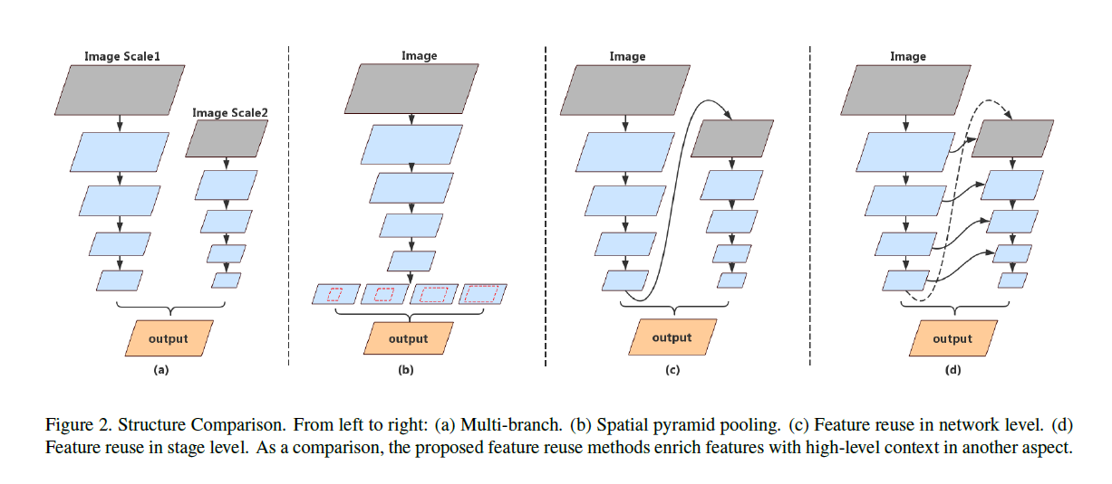
主流分割网络结构对比

Slide 3
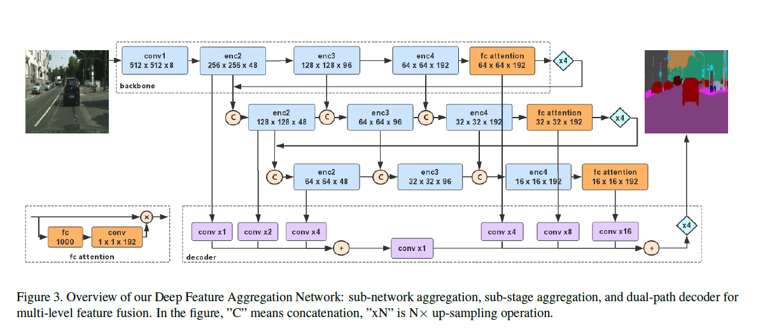
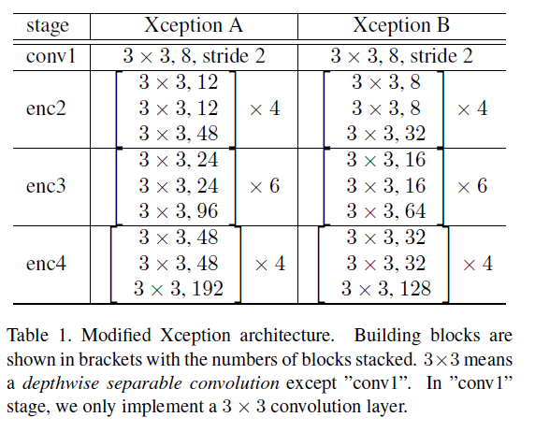
DFANet网络结构
We apply a 1*1 convolution layer followed with FC layer to reduce channels to match the feature maps from Xception backbone. Then N*C*1*1 encoding vector is multiplied with original extracted features in channel-wise manner.

Slide 4
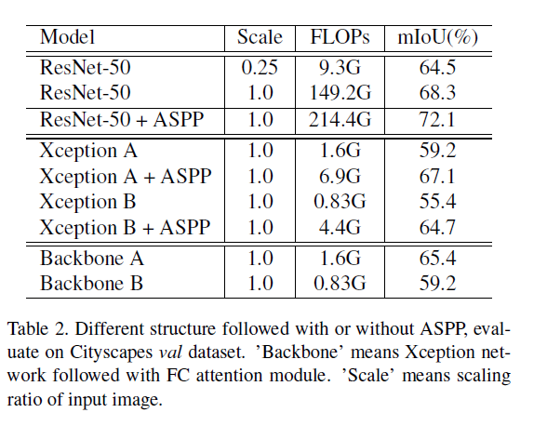
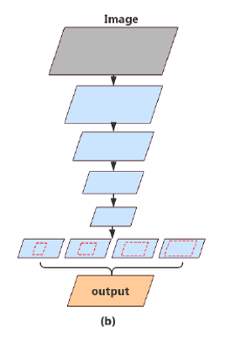
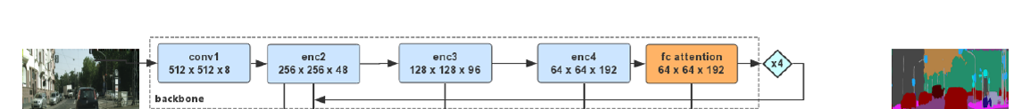
ASSP

Slide 5
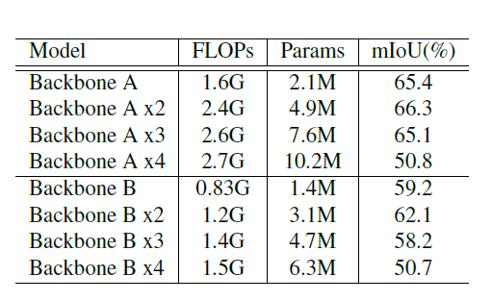
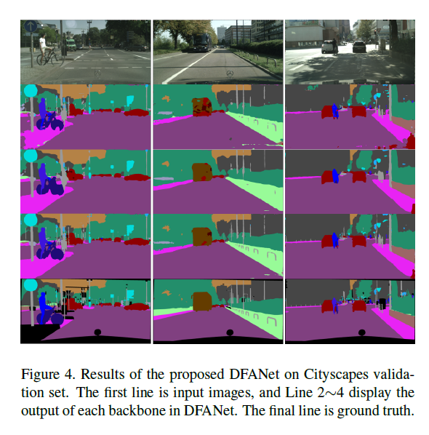
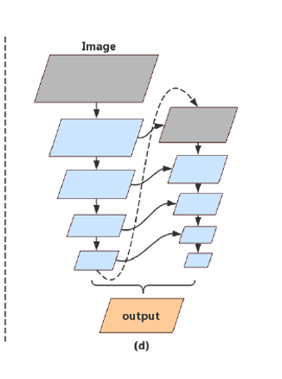
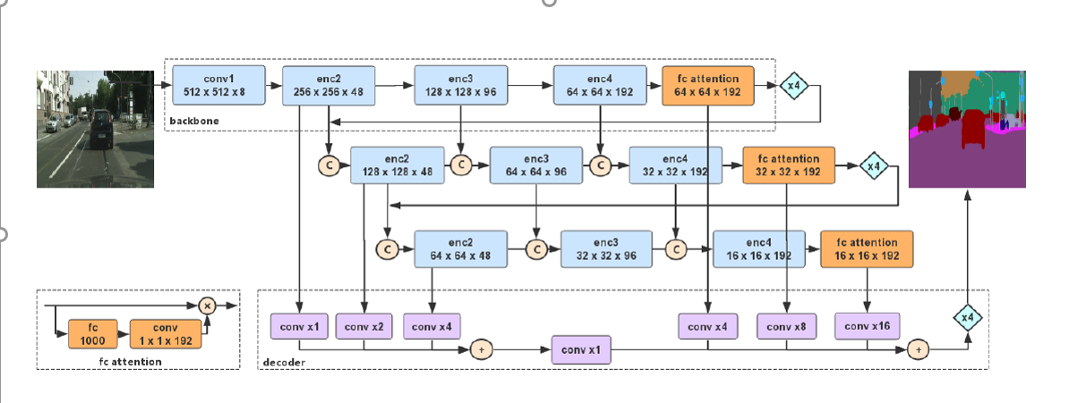
we investigate the effect of aggregation strategy in our proposed network. Our feature aggregation is composed of sub-network aggregation and sub-stage aggregation. We replicate backbones to show the performance on Cityscapes val set.

Slide 6
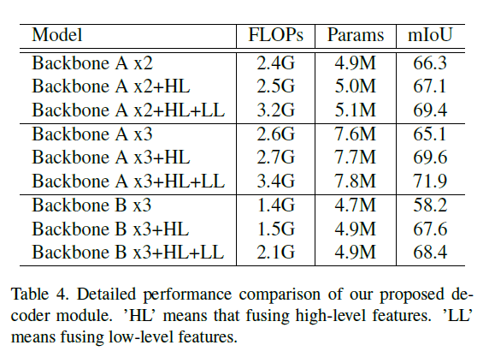
完整的DFANet

Slide 7
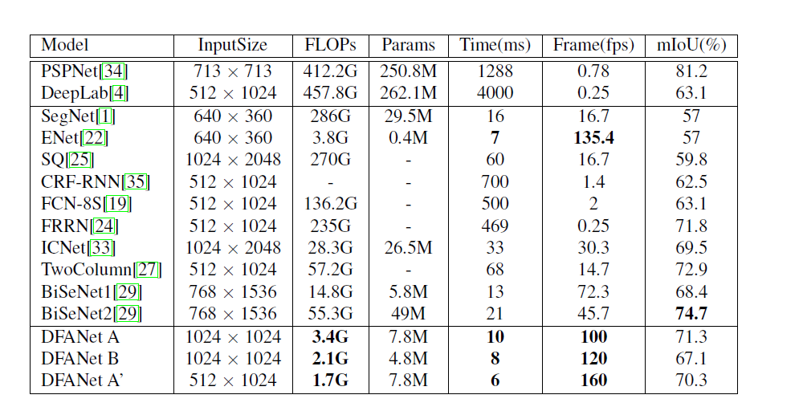
性能比较

